Slide 1
Fashion-mnist dataset
Haja Amir Rahman
DAAAFT2B06
P2100803

Slide 2
TABLE OF CONTENTS
01.
02.
03.
data exploration
simple baseline model
own model
04.
05.
06.
data augmentation
Model Improvement
conclusion

Slide 3
01.
Exploratory data analysis (EDA)

Slide 4
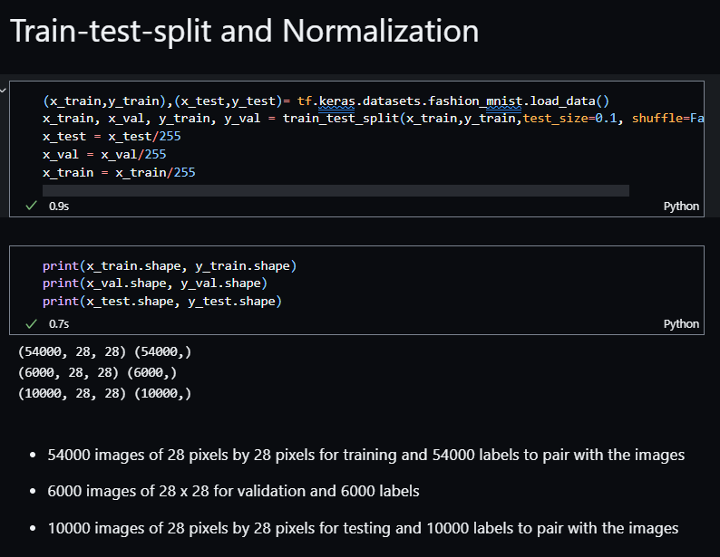
EDA
Class names
Tshirt/top, Trouser, Pullover, Dress, Coat, Sandal, Shirt, Sneaker, Bag, Ankle Boot
Train-test-VAL-split & normalization
X_train, y_train, x_val, y_val and x_test, y_test

Slide 5
02.
Simple baseline model
You can enter a subtitle here if you need it

Slide 6
process
Architecture
Building
evaluation
Used a simple architecture of 1 Conv2D layer, 1 Flatten and 2 Dense layers
X_train, y_train, validation_data(x_val, y_val)
After fitting the model, I used model checkpoints as callback in the fitting process to get the best weight and evaluate

Slide 7
Model evaluation
Used tf.keras.callbacks.ModelCheckpoint() function to monitor for the best validation accuracy and loss produced while fitting the model
Used the same method to save the model with the best weight using the h5 extension.
Thanks to the callback and checkpoint method, I could use the load_weights function to import the best validation accuracy and loss checkpoints for model evaluation on the test data. This method allowed for the most accurate accuracy and loss values for analysis.
I employed this same method for the rest of the models compiled and fitted for this section of the assignment

Slide 8
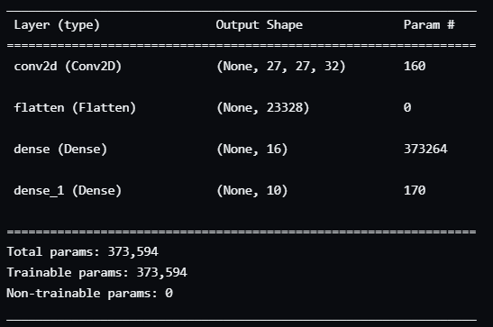
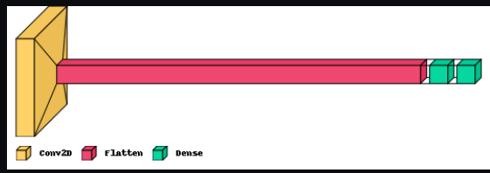
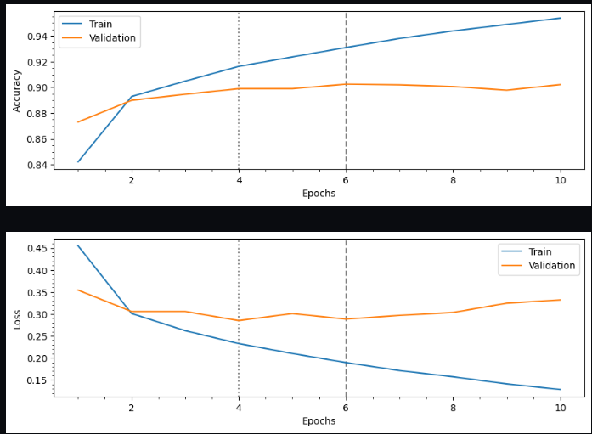
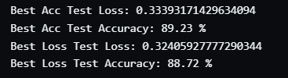
Baseline model architecture and evaluation

Slide 9
03.
Own model
You can enter a subtitle here if you need it

Slide 10
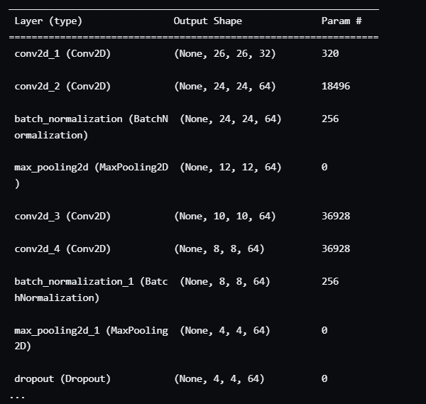
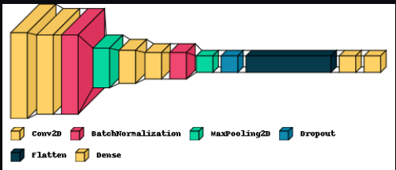
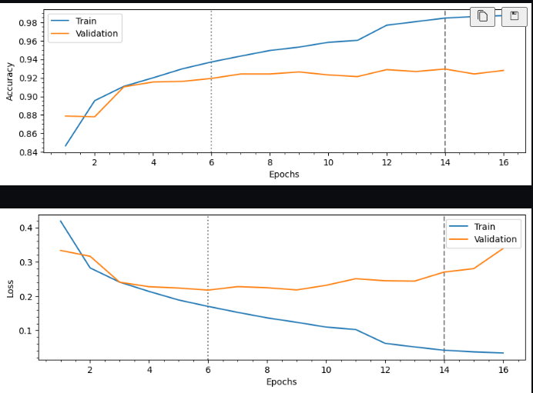
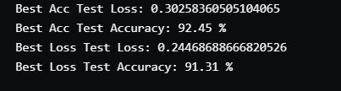
Own model architecure and evaluation

Slide 11
04.
Data augmentation
You can enter a subtitle here if you need it

Slide 12
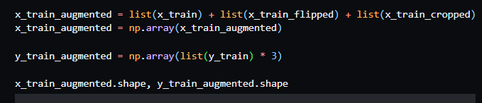
augmentation
Normalization
Mercury is the closest planet to the Sun
Flipped images
x_train_flipped
Cropped images
x_train_cropped
Added all training data using numpy array
Since x_train data has been tripled, I tripled the y_train data as well otherwise it would not make sense when I build and run the models

Slide 13
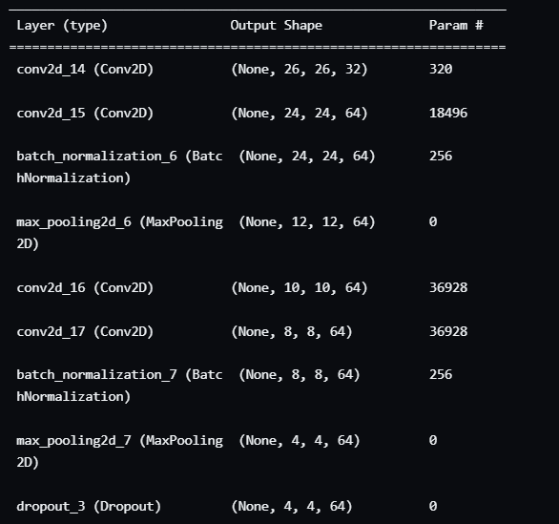

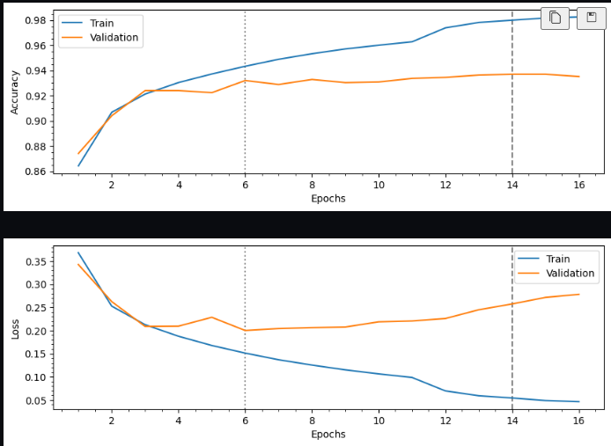
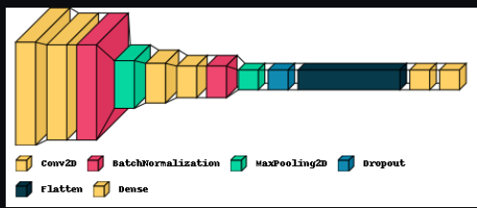
Own augmented model architecture AND EVALUATION
Own Model Augmented Test Accuracy and Loss

Slide 14
05.
Model improvement
You can enter a subtitle here if you need it

Slide 15
Tensore core keras tuner
visuals
Keras Hyperband
Early stopping callback
Early stopping is used to monitor for max validation accuracy with a patience of 5 as the number of epochs to run is 50
Number of units in first densely connected layer and optimal learning rate
Graphs plotted to show the difference in performance between the hyper model fit with and without augmented data

Slide 16
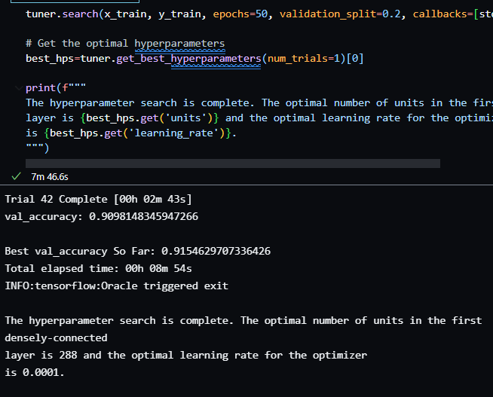
Hyperparameters
Optimal number of neurons in first densely-connected layer: 288
Optimal Learning Rate for Optimizer is 0.0001
Best Validation Accuracy so far: 0.915 (3 d.p.)

Slide 17
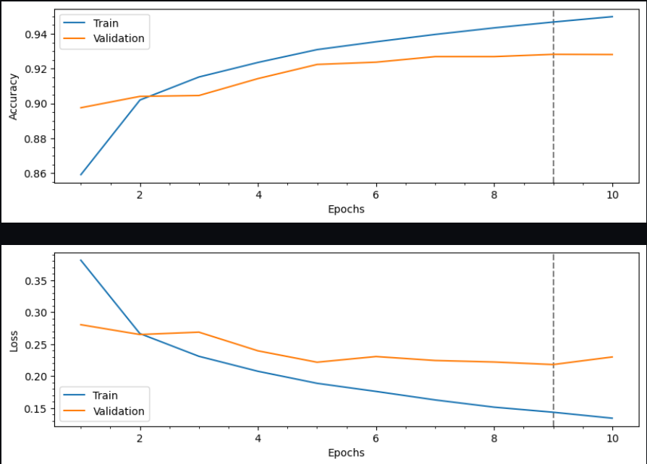
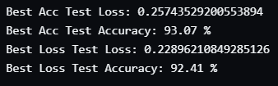
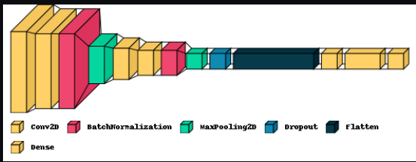
Graph for Hyper model with augmentation

Slide 18
06.
Conclusion
You can enter a subtitle here if you need it

Slide 19
Final Verdict non-augmented hyper model- improve by 0.5-1%
Final Verdict augmented hyper model - improve to 93% (best)
Both hyper models took the longest to run as the hyperband tuner search on normal and augmented train data took over 40 trials

Slide 20
THANKS
Do you have any questions?
youremail@freepik.com
+91 620 421 838
yourcompany.com
Please keep this slide for attribution

